Slide 1
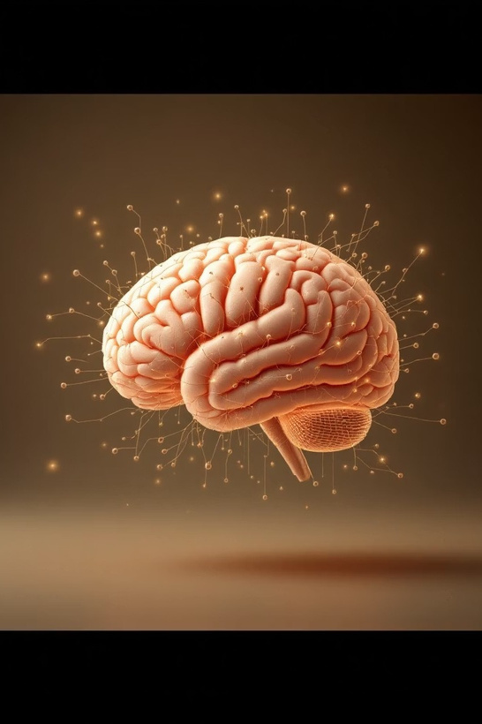
Facial Emotion Recognition
A Deep Learning Approach to
Understanding Human Affect
SubmittedBy:AnkurRathi (Reg.No:2427030014)
Manipal University Jaipur, 4th Semester Supervised By: Mrs. Harshika Mathur, Department of Computer Science and Engineering

Slide 2
CHAPTER 1
Presentation Outline: Our Journey
Thispresentationguidesusthroughthefoundation,development,andapplicationofaFacialEmotion Recognition (FER) system.
01
Introduction to FER
02
Literature Review
Defining the field and its significance.
Exploring historical and modern approaches.
03
Problem Statement & Objectives
Identifying the core challenge and goals.
04
Proposed Solution
Our deep learning pipeline for emotion classification.
05
System Implementation
Practical application with a dashboard and report generation.
06
References
Acknowledging key contributions.

Slide 3
CHAPTER 2
Introduction: What is Facial Emotion Recognition
(FER)?
FER is a pivotal area in computer vision and machine learning, focusing on identifying human emotions from facial expressions.
Core Function
Key Emotions Detected
Analyzes facial landmarks (eyes, mouth, eyebrows, nose) to detect and classify emotions.
Happiness, sadness, anger, surprise, fear, and disgust.
Technological Shift
Deep learning significantly improved the accuracy and robustness of FER systems, enabling real-world applications.

Slide 4

CHAPTER 3
Diverse Applications of FER
Technology
Theabilitytoautomatically interpretemotionalstatesopensuptransformative
possibilitiesacrossvarious sectors.
Human-Computer Interaction
Adaptive interfaces respond to emotional states, enhancing user experience.
Healthcare & Well-being
Patient monitoring, emotional disorder analysis, and pain detection.
Education & E-learning
Detects student engagement and frustration, allowing for personalized learning adjustments.
Marketing & Advertising
Measures audience reactions in real-time to optimize content effectiveness.

Slide 5
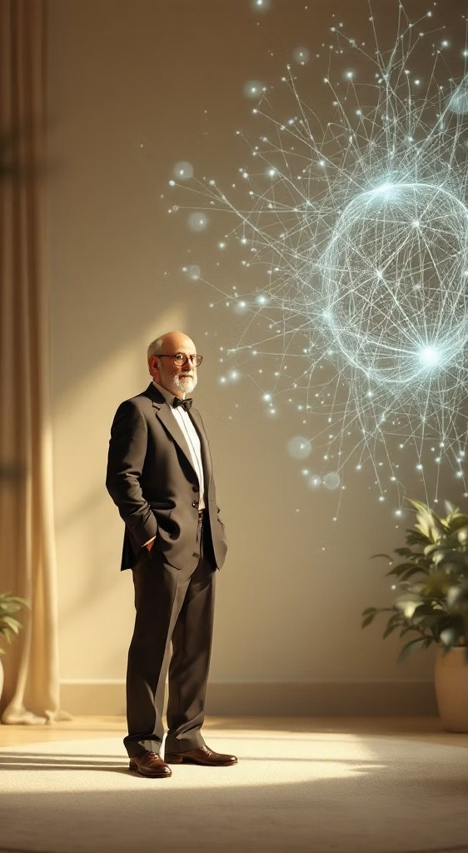
CHAPTER 4
Literature Review:
Foundations and Evolution
TheevolutionofFERspansfrompsychologicaltheoriesofuniversalemotions to
advanced deep learning models.
1
1978: Universal Emotions
Ekman & Friesen proposed six universal emotions.
2
Early Approaches
Pre-Deep Learning: LBP, HOG features with SVM classification.
3
Modern Deep Learning Era
CNN architectures like VGGNet and ResNet improved accuracy significantly.
4
Key Datasets for Training
FER2013, CK+, JAFFE, AffectNet provide rich data for model development.

Slide 6

CHAPTER 5
Challenges in Robust Emotion
Recognition
Despite progress, achieving high accuracy in real-world scenarios remains
complex.
Illumination and Lighting
Variability
Head Pose and Orientation
Occlusion (glasses, hair, hands,
etc.)
Cultural Nuances in Expression

Slide 7

CHAPTER 6
Problem Statement: Accurate Emotion Classification
Thecore challengeisto developa robustandhighlyaccuratesystemcapableofautomatically detectingandclassifyinghumanfacial
emotions from diverse image and video inputs, leveraging modern image processing and deep learning techniques.
Diverse Data Handling
Aggregate varied images and annotations
Advanced Image Processing
Preprocess, augment,and normalize inputs
Deep Learning Accuracy
Trainrobustmodelsforhighclassification
accuracy
This addresses the need for reliable emotional intelligence in AI systems.

Slide 8
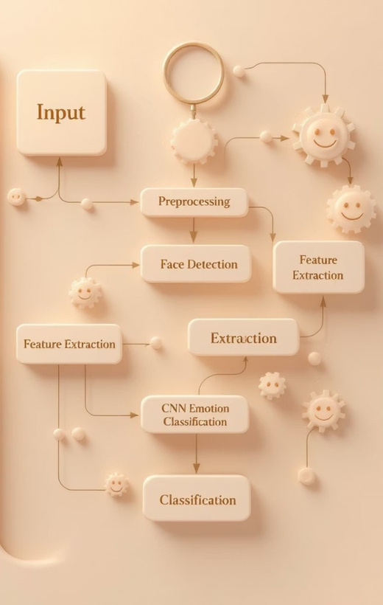
CHAPTER 7
Proposed Solution: A Deep
Learning Pipeline
Ourproposed systemusesasequence ofcomputervision techniques
culminatingin aConvolutionalNeural Network(CNN)for emotion classification.
1
Input & Preprocessing
Convert to grayscale, normalize pixels, and resize images.
2
Face Detection
Detect the face region using Haar Cascade / MTCNN algorithms.
3
Feature Extraction & Classification
CNN extracts deep features and predicts the emotion class.

Slide 9
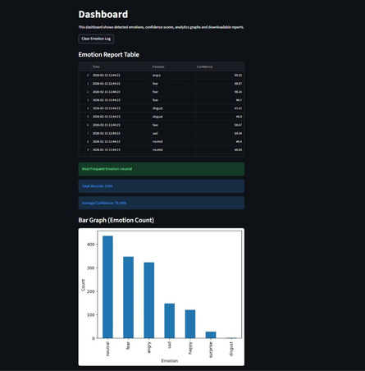
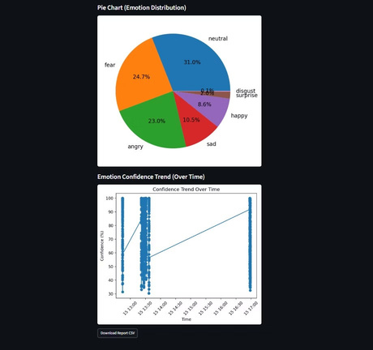
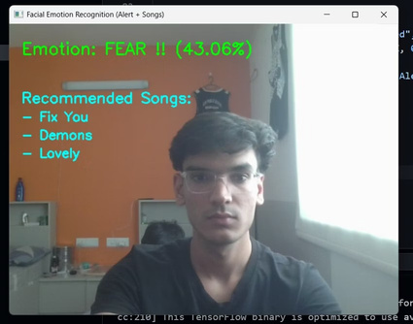
Results / Output

Slide 10




CHAPTER 8
System Implementation:
Dashboard & Report
Generation
To extendthe basicFERmodelintoareal-worldsystem,ananalytics dashboard
is integrated forpracticalutility.
1
2
Real-time Detection
Streamlit Dashboard
Captures emotions via webcam, logging data with timestamps.
Provides interactive analytics with bar and pie chart visualizations.
3
Downloadable Reports
Generates summaries including emotion logs, frequent emotions, and confidence scores.

Slide 11


CHAPTER 9
Project Objectives and Goals
Our project aims to achieve comprehensive and high-performance facial
emotionrecognition.
Facial Expression Analysis
Analyze expressions to accurately map them to emotion categories.
Model Implementation
Implement custom or pre-trained deep learning architectures for optimal performance.
Performance Benchmarking
Achieve high accuracy and robust results on public datasets.
Real-Time Application
Develop and implement real-time emotion detection via webcam.

Slide 12
Thank You
Weappreciate yourattentionand engagement during this presentation. Your insights and questions are invaluable as we explore the
future of Facial Emotion Recognition.
Ankur Rathi Manipal University Jaipur, 4th Semester Department of Computer Science and Engineering

